Slide 1

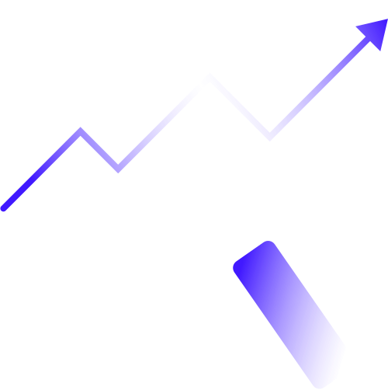

Advanced Information Visualization for
Stock Market Analysis
Presented by:
Khwaab Thareja | kt3180
Shweta Shekar | ss19623

Slide 2


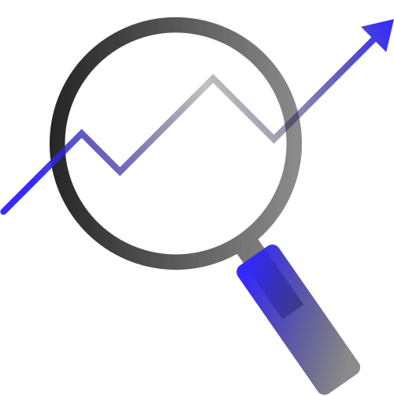
Overview
This project aims to create an advanced information visualization tool for analyzing stock market data, specifically focusing on the top 10 or top 20 stocks listed on the New York Stock Exchange (NYSE). The goal is to provide clear, actionable insights for the general public, who may not be well-versed in stock market terminology or trends. By leveraging data from yfinance, we will visualize key parameters that influence stock performance and investment decisions.

Slide 3


1. To simplify stock market analysis for the general public.
2. To provide sentiment and analyst decision recommendations based on data-driven insights.
3. To explore and visualize various aspects of stock performance and market trends
Objectives:

Slide 4


Parameters
for
Analysis
- Stock
- Market Open
- Market Close
- Market High
- Market Low
- Stock Volume
- Price to Earnings Ratio
- Market Cap
- Dividend Yield
- 52 Week Change %
- Debt to Equity
- Revenue Growth
- Profit Margin
- Industry Trend

Slide 5



Key Questions to Answer:
- Sentiment: Is the stock performing well (Good), moderately (Moderate), or poorly (Bad)?
- Analyst Decision: Should the stock be bought or held?

Slide 6

Project Phases
1. Risk Assessment:
- Volatility of NYSE stocks over time.
- Correlation of stock price movements of major NYSE companies.
2. Data Exploration:
- Top 10 NYSE stocks by market cap.
- Changes in stock prices of major NYSE-listed companies over the past year.
- NYSE sectors showing the highest growth in the last quarter.
3. Financial Performance:
- Movement of P/E ratios across different NYSE stock sectors.
- Dividend yield distribution among NYSE stocks.
- Companies with consistently increasing earnings per share over the last 4 years.
4. Trend Analysis:
- Trading volume changes during major market events.
- Seasonal patterns in stock performance for different NYSE sectors.
- Correlation of NYSE stock prices with key economic indicators.
5. Comparative Analysis:
- Performance differences between value and growth NYSE stocks.
- Comparison of NYSE-listed international companies with domestic ones.

Slide 7



Techniques and Tools:
Data Collection: yfinance API for real-time and historical stock data.
Data Processing: Python for data cleaning and preprocessing.
Visualization:
Static Visualizations: Using Matplotlib for creating bar charts, line graphs, scatter plots, and histograms.
Dynamic Visualizations: Utilizing Bokeh for interactive plots that allow users to explore data in real-time.
Advanced Visualizations: Implementing D3.js for complex, animated visualizations that provide deeper insights.

Slide 8
Expected Timeline
November 1: Complete web scraping and initial data processing.
November 14: Finalize UI/UX design for the web app.
November 30: Integrate visualization features and conduct initial testing.
December 7: Collect user feedback and make necessary adjustments.
December 9: Finalize and present the project.

Slide 9
Challenges
Data Quality and Availability: Ensuring that the yfinance data is accurate and complete for all selected stocks.
Complexity of Visualizations: Implementing advanced and interactive visualizations with tools like D3.js may require significant time and expertise.
User Accessibility: Designing visualizations that are both informative and easy for non-experts to interpret.
Performance: Handling and rendering large datasets in real-time while maintaining good performance.
Integration of Multiple Tools: Coordinating different tools (Matplotlib, Bokeh, D3.js) for a seamless experience.

Slide 10

Future Scope
Enhanced Predictive Analysis: Incorporating machine learning models for predictive stock market trends and forecasting.
Expansion to Global Markets: Extending the tool to cover major global stock exchanges and indices for comprehensive insights.
User Customization: Allowing users to tailor visualizations and parameters based on their preferences and investment goals.
Integration with Financial News: Adding real-time news feeds and sentiment analysis to correlate stock movements with current events.

Slide 11
Division of Labour
Enhanced Predictive Analysis: Incorporating machine learning models for predictive stock market trends and forecasting.
Expansion to Global Markets: Extending the tool to cover major global stock exchanges and indices for comprehensive insights.
User Customization: Allowing users to tailor visualizations and parameters based on their preferences and investment goals.
Integration with Financial News: Adding real-time news feeds and sentiment analysis to correlate stock movements with current events.

Slide 12
Conclusion
The proposed project will deliver a comprehensive visualization tool that not only simplifies stock market analysis but also provides clear investment recommendations. By combining advanced visualization techniques with insightful data analysis, we aim to empower users to make informed investment decisions.

Slide 13


Thank You

